Slide 1
Score Visuals
File created on: 7/30/20 9:53:03 PM CDT

Slide 2
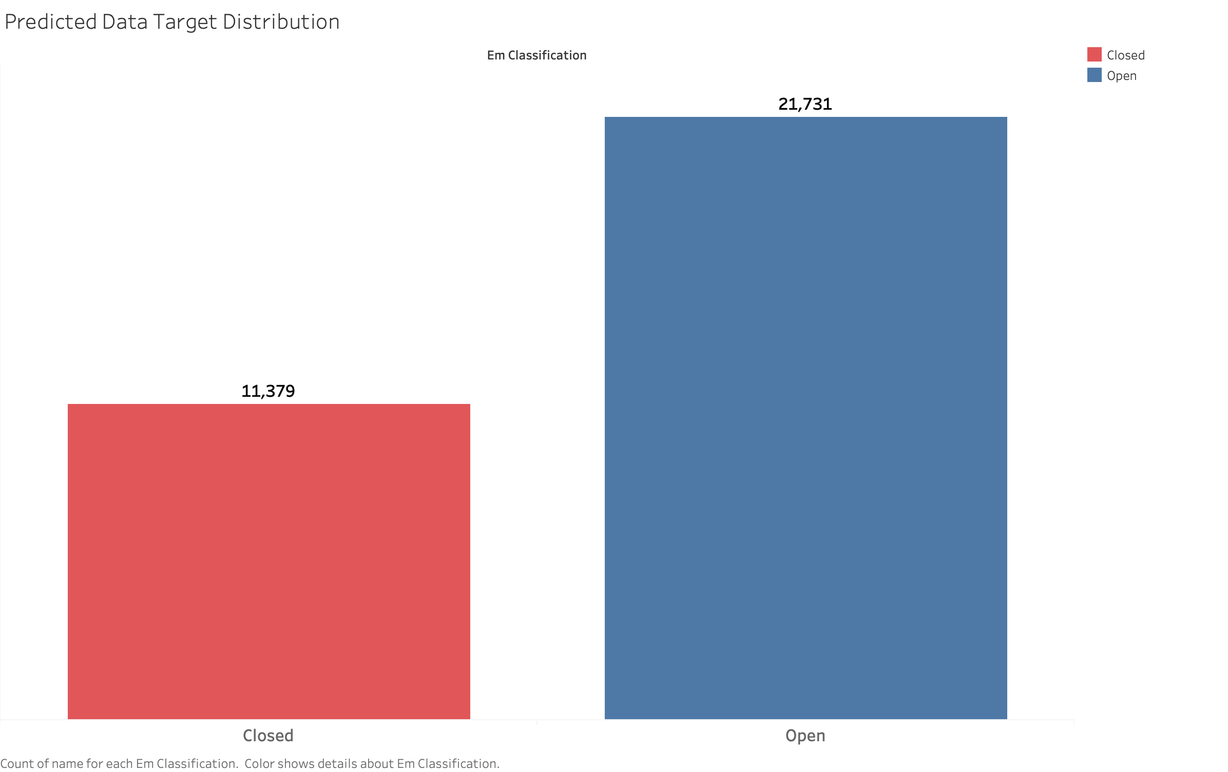

Slide 3
